Slide 1
UCIe MBINIT
V.SRAVANTHI
CHIPWEAVE TECHNOLOGIES PVT LMD

Slide 2
CONTENTS
INTRODUCTION
MBINIT.PARAM
MBINIT.CAL
MBINIT.REPAIRCLK

Slide 3
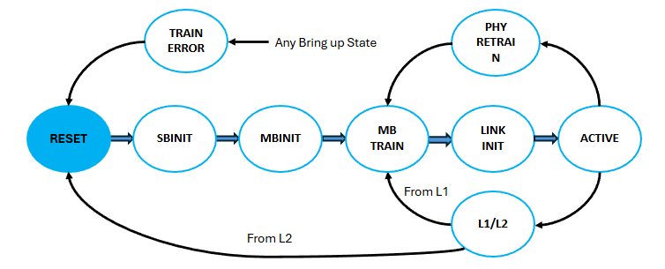
Link Training State Machine

Slide 4
MBINIT
In this state, the mainband (MB) interface is initialized and repaired or width degraded (when applicable).
The data rate on the mainband is set to the lowest supported data rate (4 GT/s).
For Advanced Package interconnect repair may be needed. Sub-states in MBINIT allows detection and repair of data, clock, track and valid Lanes.
For Standard Package, where no Lane repair is needed, sub-states are used to check functionality at lowest data rate and width degrade if needed

Slide 5
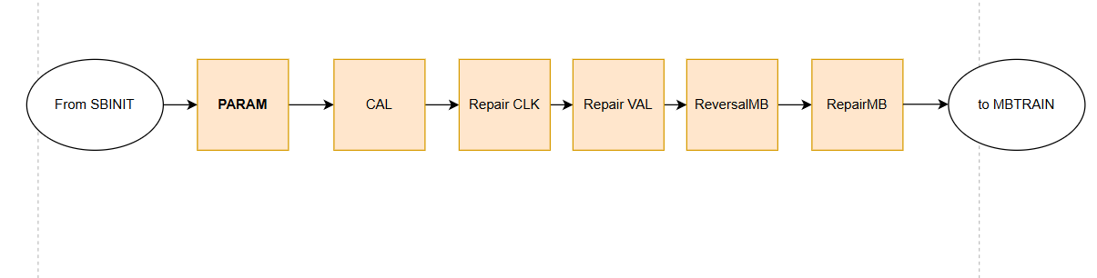
MBINIT: Mainband Initialization and Repair Flow

Slide 6
MBINIT.PARAM
This state is used to perform exchange of parameters that are required to set up the maximum negotiated speed and other PHY settings.
The following parameters are exchanged over sideband with UCIe Module Partner:
1.Voltage swing: The five bit value indicates the Transmitter voltage swing to the UCIe Module Partner.
The UCIe Module Partner must use this value and its Receiver termination information to set the reference voltage (Vref) for its Receivers.
The corresponding bits in {MBINIT.PARAM configuration resp} are reserved.

Slide 7
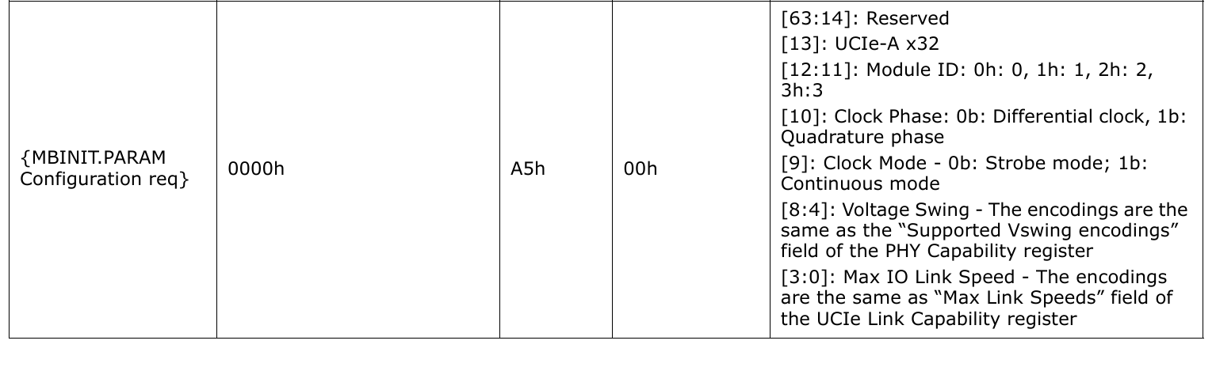

Slide 8
2.Maximum Data Rate:
The four bit value indicates the Maximum supported Data rate to the UCIe Module Partner.
The UCIe Module Partner must compare this value with its supported maximum data rate and must respond with the maximum common data rate encoding in {MBINIT.PARAM configuration resp}.
3.Clock Mode:
Clock Mode bit tells the UCIe Module Partner whether a strobe clock or a continuous clock is requested.
The Module Partner must configure its clock transmitter to match this requested mode.
The MBINIT.PARAM configuration response must reflect the same value (continuous mode uses a free-running clock).
Strobe mode uses a clock that is only active during data transfer and is not free-running continuously.

Slide 9
3.Clock Phase:
The one bit value indicates the UCIe Module’s request to UCIe Module Partner for the Clock Phase support on UCIe Module’s forwarded clock.
This should only be set 1b if the maximum data rate advertised is permitted to do so.
The corresponding bit in {MBINIT.PARAM configuration resp} must be set to 1b if this was requested and the operational data rate allows it.
4.Module ID:
The UCIe Module sends its “Module ID”.
This can be used by the UCIe Module Partner if in a multi-module configuration for Byte mapping, Module enable/disable information etc.
The corresponding bits in {MBINIT.PARAM configuration resp} are reserved.

Slide 10
UCIe-A x32:
This bit is set to 1b when APMW bit in DVSEC UCIe Link Capability register is set to 1b (OR) ‘Force x32 width mode in x64 Module’ in the PHY Control register is set
otherwise, the bit is set to 0b.
If a x64 Advanced Package module supports width reduction to interoperate with a x32 Advanced Package Module, it uses this information from its link partner to condition the results during MBINIT.REVERSALMB.
The corresponding bits in {MBINIT.PARAM configuration resp} are reserved

Slide 11
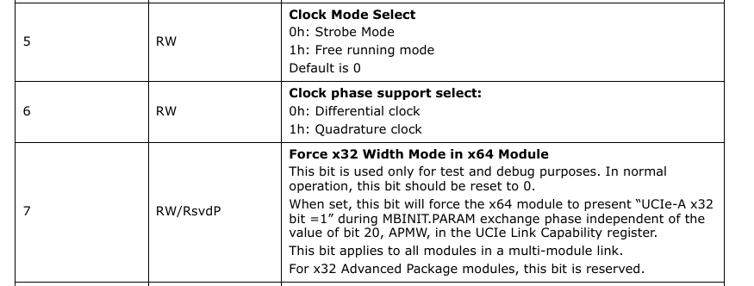
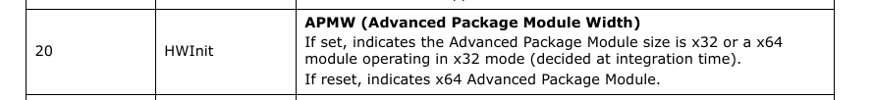

Slide 12
MBINIT.PARAM
DIE 0 : UCIe Module
DIE 1 : UCIe Module Partner
.
{MBINIT.PARAM configuration req}
{MBINIT.PARAM configuration resp}
MBINIT.CAL

Slide 13
MBINIT.CAL
This state is used to perform any calibration needed
Tx Duty Cycle correction
Receiver offset
Vref calibration.
This state is common for both Advanced Package and Standard Package
The UCIe Module maintains tri-state on all its mainband Transmitters, and mainband Receivers are permitted to be disabled in this state.

Slide 14
MBINIT.CAL
DIE 0 : UCIe Module
DIE 1 : UCIe Module Partner
{MBINIT.CAL Done req}
{MBINIT.CAL Done resp}
MBINIT.REPAIR CLK

Slide 15
MBINIT.REPAIRCLK
This sub-state is used to detect and apply repair to clock and track Lanes for Advanced Package and for functional check of clock and track Lanes for Standard Package.
Signal Group | Full Form / Description
TCKP_P / RCKP_P | Transmit / Receive Clock Positive (P-side)
TCKN_P / RCKN_P | Transmit / Receive Clock Negative (P-side)
TTRK_P / RTRK_P | Transmit / Receive TRacKing Signal
TRDCK_P / RRDCK_P | Transmit / Receive ReDundant ClocK

Slide 16
MBINIT.REPAIRCLK for Std Package
DIE 0 : UCIe Module
DIE 1 : UCIe Module Partner
{ MBINIT.REPAIRCLK init Req }
When ready to receive pattern on RCKP_L,RCKN_L and RTRK_L
{ MBINIT.REPAIRCLK init Resp }
--------------------------------------
Sends 128 iterations of clock repair patterns(16 clock cycles followed by 8 cycles of low) on TCKP_L,TCKN_L and TTRK_L
Detects this pattern on RCKP_L,RCKN_L and RTRK_L. Detection is considered successful if at least 16 consecutive cycles of clock repair pattern are detected.it logs the detection result for RCKP_L,RCKN_L and RTRK_L.
If detection is not success on any one of the RCKP_L,RCKN_L and RTRK_L
{ MBINIT.REPAIRCLK result Req }
{ MBINIT.REPAIRCLK result Resp }
Both goes to TRAINERROR after TRAINERROR handshake
If detection is successful
MBINIT.REPAIRCLK done Req
MBINIT.REPAIRCLK done resp}
MBINIT.REPAIRVAL

Slide 17
MBINIT.REPAIRCLK for Advanced Package
DIE 0 : UCIe Module
DIE 1 : UCIe Module Partner
{ MBINIT.REPAIRCLK init Req }
ready to receive pattern on RCKP_L, RCKN_L, RTRK_L, and RRDCK_L
{ MBINIT.REPAIRCLK init Resp }
--------------------------------------
Sends 128 iterations of clock repair patterns(16 clock cycles high followed by 8 cycles of low) on TCKP_L only
Detects this pattern on RCKP_L,RCKN_L and RTRK_L & RRDCK_L.Detection is considered successful if atleast 16 consecutive cycles of clock repair pattern are detected.it logs the detection result for RCKP_L,RCKN_L and RTRK_L &RRDCK_L
Detected on any of them unsuccessfully
Repair is needed
{ MBINIT.REPAIRCLK result Req }
Detected on any 2
Electrical short
{ MBINIT.REPAIRCLK result Resp }
No repair
Detection successful only on RCKP_L
Above steps are repeating for TCKN_L,TTRK_L and TRDCK_L

Slide 18
MBINIT.REPAIRCLK for Advanced Package
DIE 0 : UCIe Module
DIE 1 : UCIe Module Partner
{MBINIT.REPAIRCLK apply repair Req }
If a repair is needed for one of the clock or track pins (CKP,CKN or TRK) and a repair resource is available ,repair is applied by Module Parter
If repair is applied,UCIe module check the repair success by applying clock repair pattern and checking on the receiver
{MBINIT.REPAIRCLK apply repair Resp }
-------------------------------------------
{ MBINIT.REPAIRCLK check repair init Req }
ready to receive and check clock repair pattern.
Sends 128 iterations of clock repair patterns(16 clock cycles high followed by 8 cycles of low) on TCKP_L only
{ MBINIT.REPAIRCLK check repair init Resp }
--------------------------------------------
Above steps are repeating for TCKN_L,TTRK_L and TRDCK_L
MBINIT.REPAIRCLK check results req
MBINIT.REPAIRCLK check results resp
Repair not successful
Both go to TRAINERROR
--------------------------------------------
MBINIT.REPAIRCLK done req
Repair is successful detected only on RCKP_L
MBINIT.REPAIRCLK done resp
REPAIRVAL

Slide 19


Slide 25
MBTRAIN.RXDESKEW Sequence
DIE 0 : UCIe Module
DIE 1 : UCIe Module Partner
Step:1
Initiates start signal
{MBTRAIN.DATATRAINCENTER2 start req}
Module partner responds
{MBTRAIN.DATATRAINCENTER2 start resp}
------------------------------------–-------
------------------------------------
---------------------------------------------
Step:2
The UCIe Module must perform a Transmitter initiated full eye width sweep or one or more Transmitter initiated point tests to determine the correct data to eye centering.
The Transmitter must be set up to send 4K UI of continuous mode LFSR pattern. The LFSR pattern on data must be accompanied by correct valid framing on the Valid Lane. The Receiver must be set up to perform per Lane comparison.
Detection on a Receiver Lane is considered successful if total error count is < the set error threshold .
---------------------------------------------
------------------------------------
---------------------------------------------
Step:3
The UCIe Module uses the received training results to calculate the final eye center and set the clock phase to sample the data eye at the optimal point to maximize eye margins.
{MBTRAIN.DATATRAINCENTER2 end req}
Module partner responds.
On handshake, Module must exit to MBTRAIN.LINKSPEED.
{MBTRAIN.DATATRAINCENTER2 end resp}

Slide 26
Receiver Initiated Data to Clock Eye Width Sweep
Introduction

Slide 27
Receiver Initiated Data to Clock Eye Width Sweep
DIE 0 : UCIe Module
DIE 1 : UCIe Module Partner
Enable Pattern Comparison ckt: Compares incoming MB data to logically generated expected pattern.
{ Start Rx Init D to C eye sweep req }
Setup the Data to Clk training parameters.
{ Start Rx Init D to C eye sweep resp }
------------------------------------
UCIe module partner resets the LFSR on its MB.
UCIe module resets LFSR and clears any prior compare results on its MB.
{ LFSR clear error req } step:2
{ LFSR clear error resp }
UCIe module partner sends the pattern (selected through "Tx Pattern Generator Setup") for the selected no.of cycles ("Pattern count setup") on its MB.
Compares each unit interval(UI) based on "Rx compare setup" during pattern transmission and logs the results.
Patterns
<----------------------------------
{ Rx Init D to C results req }
Requests logged data to clock test results.
UCIe module responds with logged results for its MB receiver.
UCIe Module Partner can determine if the pattern comparison at the PI phase passed or failed based on the results log.
{ Rx Init D to C results resp} step: 5
------------------------------------
{ Rx Init D to C sweep done with results }
Sends SB msg along with results for its MB transmitter.
Now the corresponding sequence has completed.
{End Rx Init D to C eye sweep resp}
{End Rx Init D to C eye sweep resp}

